Slide 1

Amazon
SALES
REPORT
Call Now.
+91 9467671237

Slide 2

Objective
The objective of this project is to analyze product and review data from Amazon using SQL queries. As a data analyst at Amazon, your task is to extract meaningful insights from the dataset by filtering, comparing, and identifying specific product and review attributes based on pricing, discount percentages, product names, and review content. This analysis will support the management in understanding customer behavior, pricing impact, and product performance.

Slide 3
Problems Statements
List all products with a discounted price below ₹500.
Find products with a discount percentage of 50% or more.
Retrieve all products where the name contains the word "Cable."
Display the difference between the average of the actual price and the average of discounted price for each product.
Query reviews that mention "fast charging" in their content.
Identify products with a discount percentage between 20% and 40%.
Find products that have an actual price above ₹1,000 and are rated 4 stars or above.
Find products where the discounted price ends with a 9 ?
Display review contents that contains words like worst, waste, poor, or not good.
List all products where the category includes "Accessories."

Slide 4
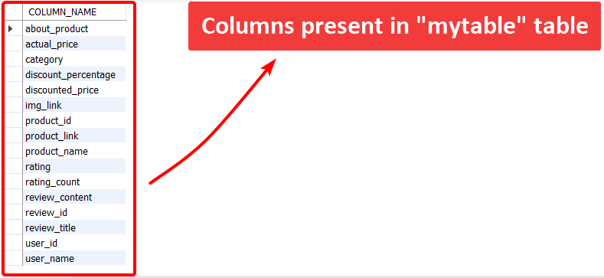
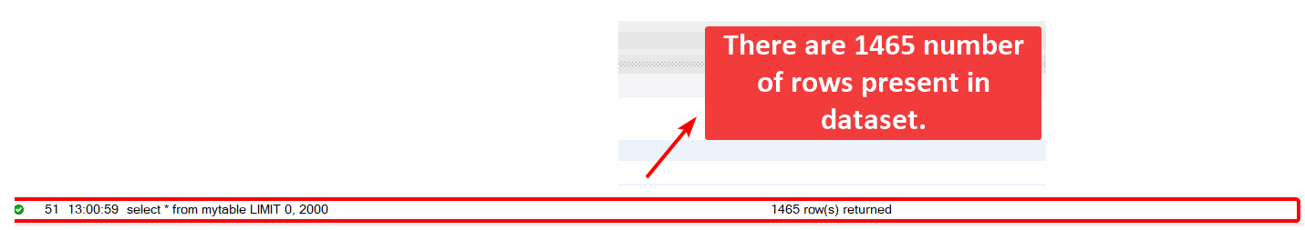
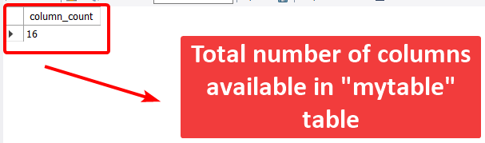
About Dataset

Slide 5
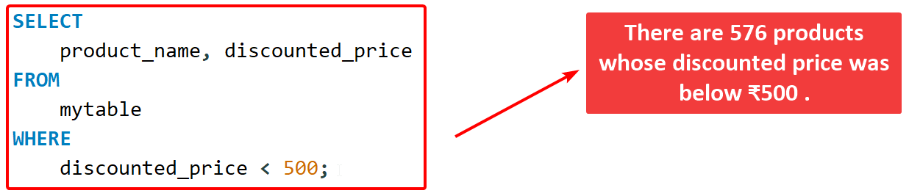
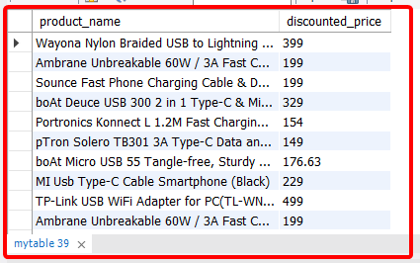
1
List all products with a discounted price below ₹500.
QUERY OUTPUT

Slide 6
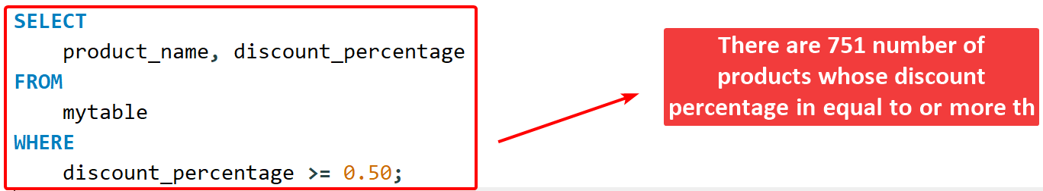
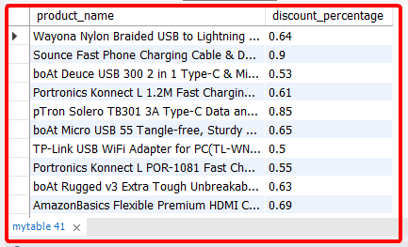
2
Find products with a discount percentage of 50% or more.
QUERY OUTPUT

Slide 7
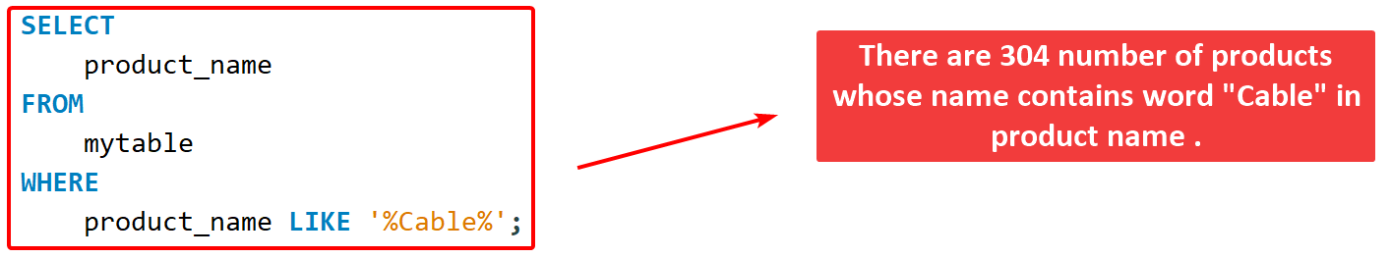
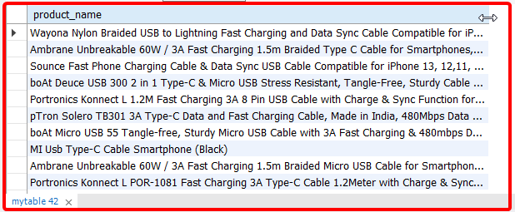
3
Retrieve all products where the name contains the word "Cable."
QUERY OUTPUT

Slide 8
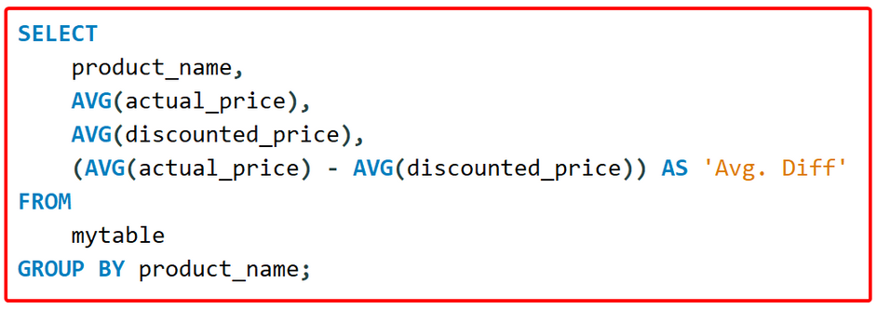
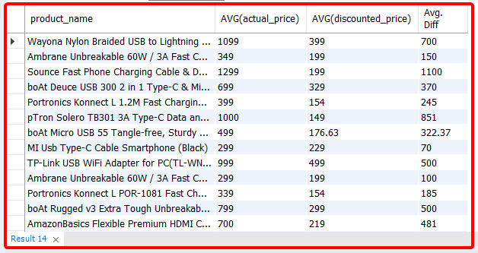
4
Display the difference between the average of the actual price and the average of discounted price for each product.
QUERY OUTPUT

Slide 9
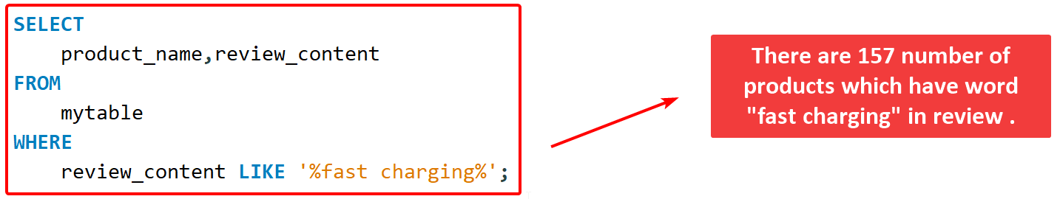
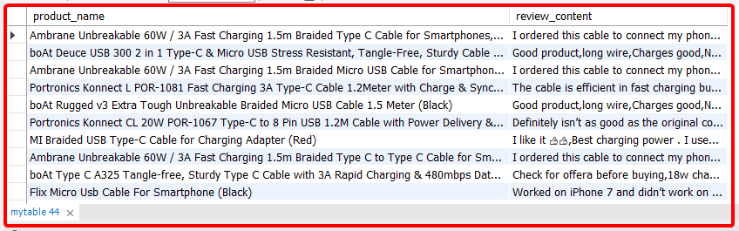
5
Query reviews that mention "fast charging" in their content.
QUERY OUTPUT

Slide 10
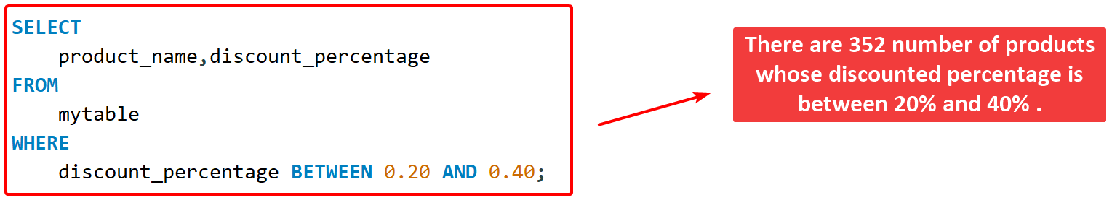
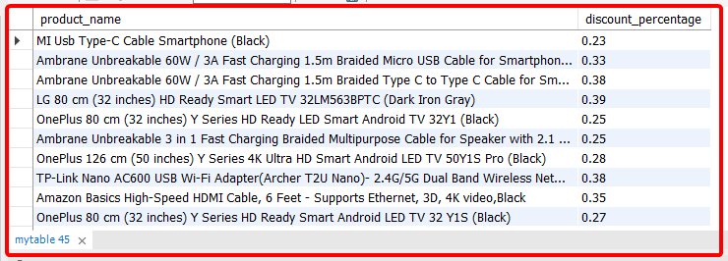
6
Identify products with a discount percentage between 20% and 40%.
QUERY OUTPUT

Slide 11
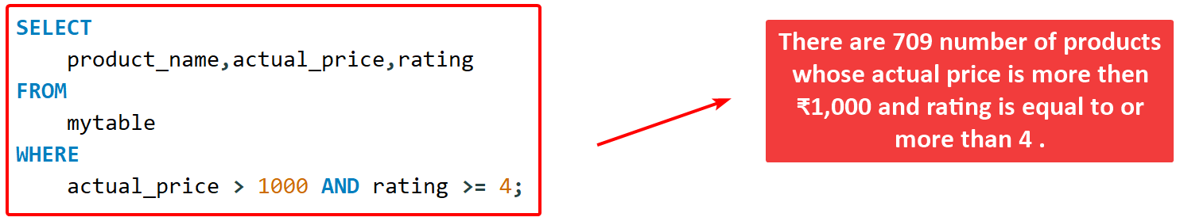
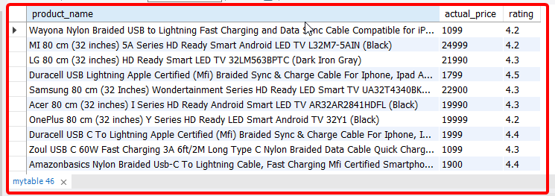
7
Find products that have an actual price above ₹1,000 and are rated 4 stars or above.
QUERY OUTPUT

Slide 12
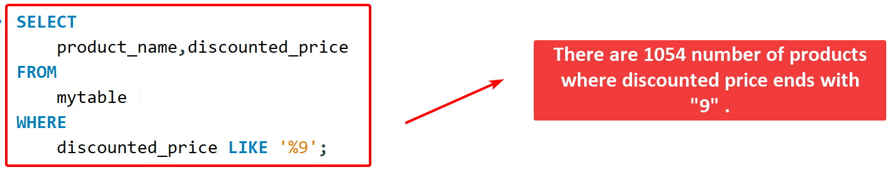
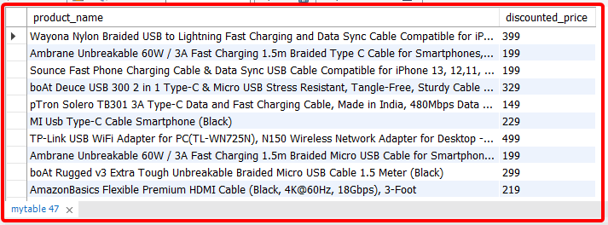
8
Find products where the discounted price ends with a 9 ?
QUERY OUTPUT

Slide 13
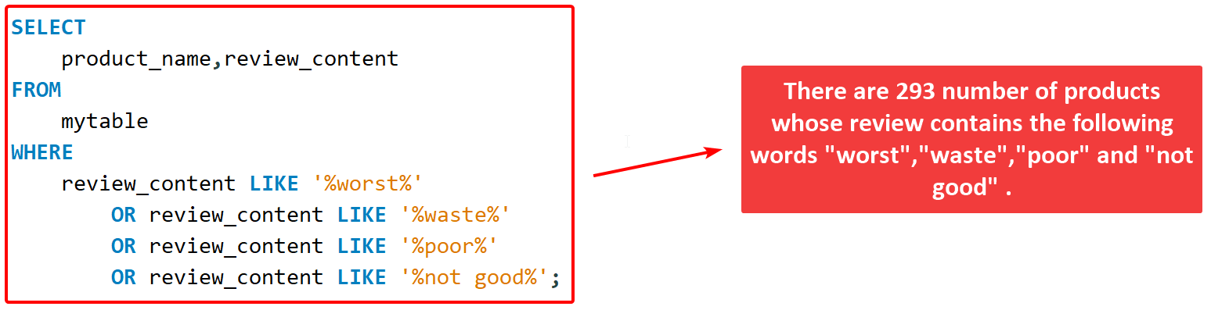
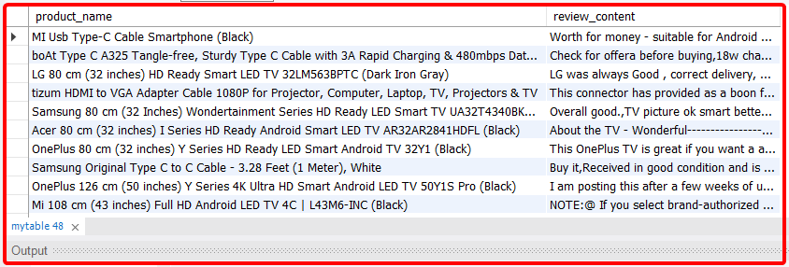
9
Display review contents that contains words like worst, waste, poor, or not good.
QUERY OUTPUT

Slide 14
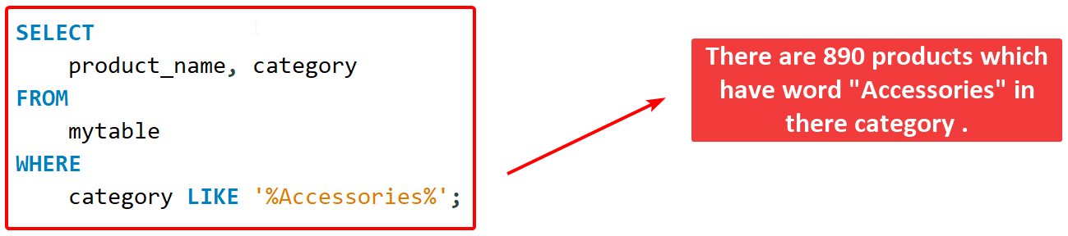
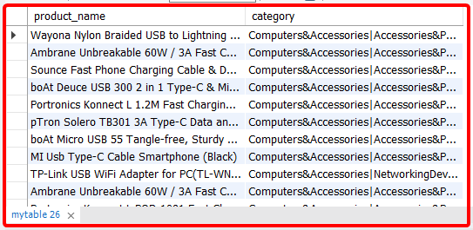
10
List all products where the category includes "Accessories".
QUERY OUTPUT

Slide 15

Thank
You
Call Now.
+91 9467671237

